Slide 1
UT Data Analytics Team 4 project 1
Research Austin crime relationship to home prices 2015-2018
(Bhavini vyas, ahmar jamal, mark findley)

Slide 2
Project motivation
Originally, we wanted to produce a “Newcomers” guide to Austin that would provide useful information to people who had moved to Austin recently, or were planning to move to Austin. The idea was to interlace school data, crime data, shopping and entertainment venues and housing prices to provide an overall view of Austin livability. We realized early on that this was probably more than we wanted to take on for the project, so we started focusing on one question we found interesting.
Over time, does a change in crime rates, have an influence over housing prices?
Our hypothesis is that an increase in crimes, over a period, will negatively impact home prices in an Austin zip code. Conversely, a decrease in violent crime, over a period, will positively impact home prices in an Austin zip code

Slide 3

Questions
Using the crime and census data, what are the crime rates per 1,000 of population in each Austin zip code?
Within each Austin zip code, what were the increases or decreases in crime rates over the period from 2015-2018 and year over year?
Within each Austin zip code, what were the increases or decreases in median home prices over the period from 2015-2018 and year over year?
What, if any, is the correlation between the two, via scatter plot, best fit line, r-square, p-square and p-value?
Notes:
QuickStarter has created an outline to help you get started on your presentation. Some slides include information here in the notes to provide additional topics for you to research.

Slide 4
Project summary
Year over year data does not provide enough data (or much insight) so we decided to look at overall % changes in crime and overall % changes in home prices from 2015 to 2018.
Currently, it does not appear that crime data (either violent or non-violent) has a significant influence on home prices in Austin. Other factors such as neighborhood location, schools, walkability, neighborhood character, property taxes and long-term value may be more important.
Overall, Austin is not a particularly violent city. This study might lend itself better to cities where violent crime is more prevalent OR to a longer-term study.

Slide 5
Data sources
US Census Data – population by zip code in Austin 2015-2018
Austintexas.gov Crime Data 2015-2018 (By zip code, violent and non-violent crime)
Austin MLS Listing Data 2015-2018 (by zip code, listing date and listing price)

Slide 6
Data clean up and exploration
2018 population has been derived from 2017 population by applying a 2.5% growth rate (which is the overall Austin population growth rate).
To limit sample bias, crime data been filtered to only include zip codes with more than 55 crimes over the course of the four years in the study.
To limit sample bias, listings data has been filtered to only include zip codes that have had more than 100 listings over the course of the four years in the study.
Listings data is using listing date and listing price rather than closing date and closing price due to data availability. Assumption being that all homes closed on the listing date for the listing price.

Slide 7
Data analysis
Crime data was merged with census data, on zip code, to produce crime rates per 1,000 population. Percentage of crime rate changes, over time, were calculated.
Median listing prices, by zip code, were calculated over time. Percentage of listing price changes, over time, were calculated.
Matplotlib was used to chart, analyze and visualize the data.
Final analysis used a scatterplot with crime rates on the x-axis and housing prices on the y-axis with each zip code as a datapoint. Best fit line was created with an r-square indicating no correlation.

Slide 8
Charts and graphs
Zip code population growth.
Austin crime by zip code.
Percent change in crime by zip code.
Percent change in violent and property crime year over year.
Crime by month.
Change in median housing prices by zip code 2015-2018.
Scatter plot matching % changes in crime by zip code vs. % changes in housing prices from 2015-2018.

Slide 9
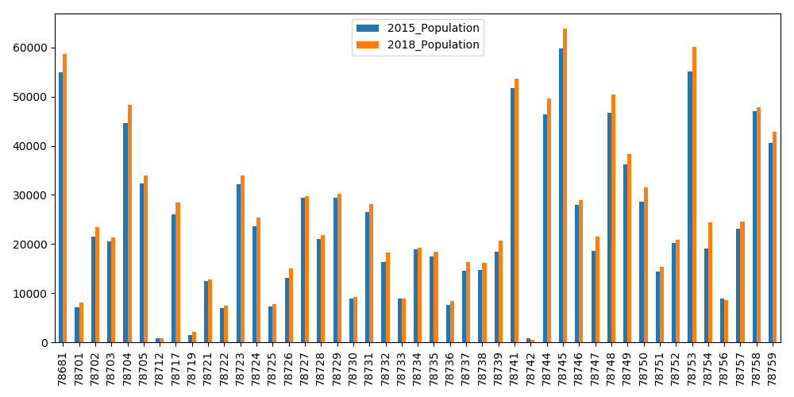
Change in population by zip code (2015-2018)
Steady growth was seen over the four years across almost all zip codes.

Slide 10
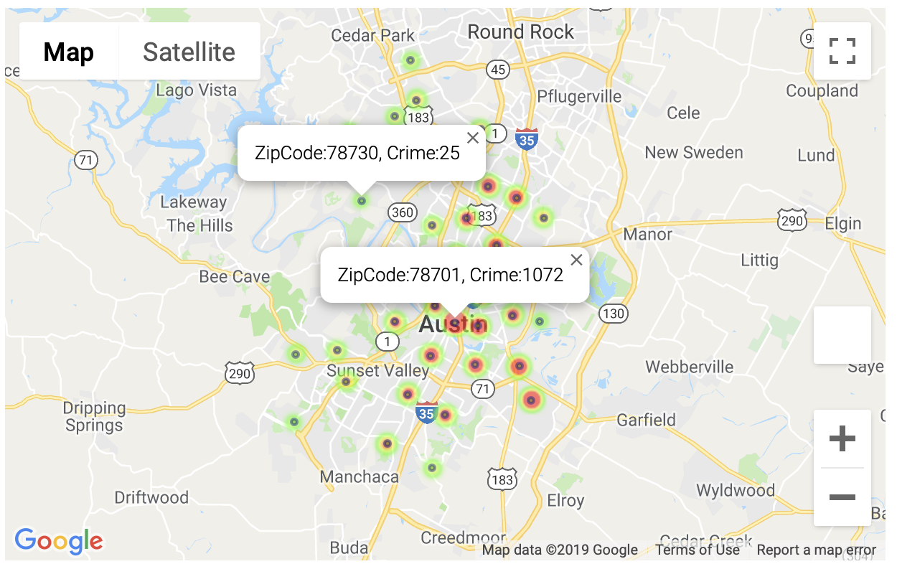
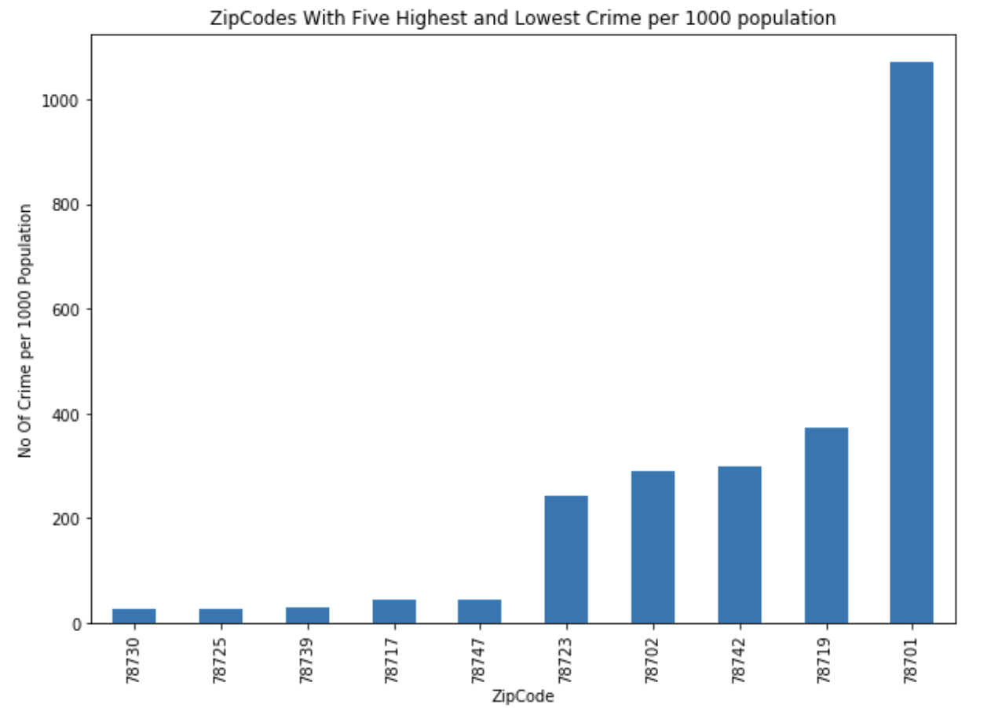
Austin TOTAL crime PER 1000 POPULATION by zip code (2015-2018)
Lowest crime zip codes are north and west of Austin.
78701 is the highest crime zip code, not surprising as that is where 6th Street and the Arch are. Other high crime zip codes are south and east of town.

Slide 11
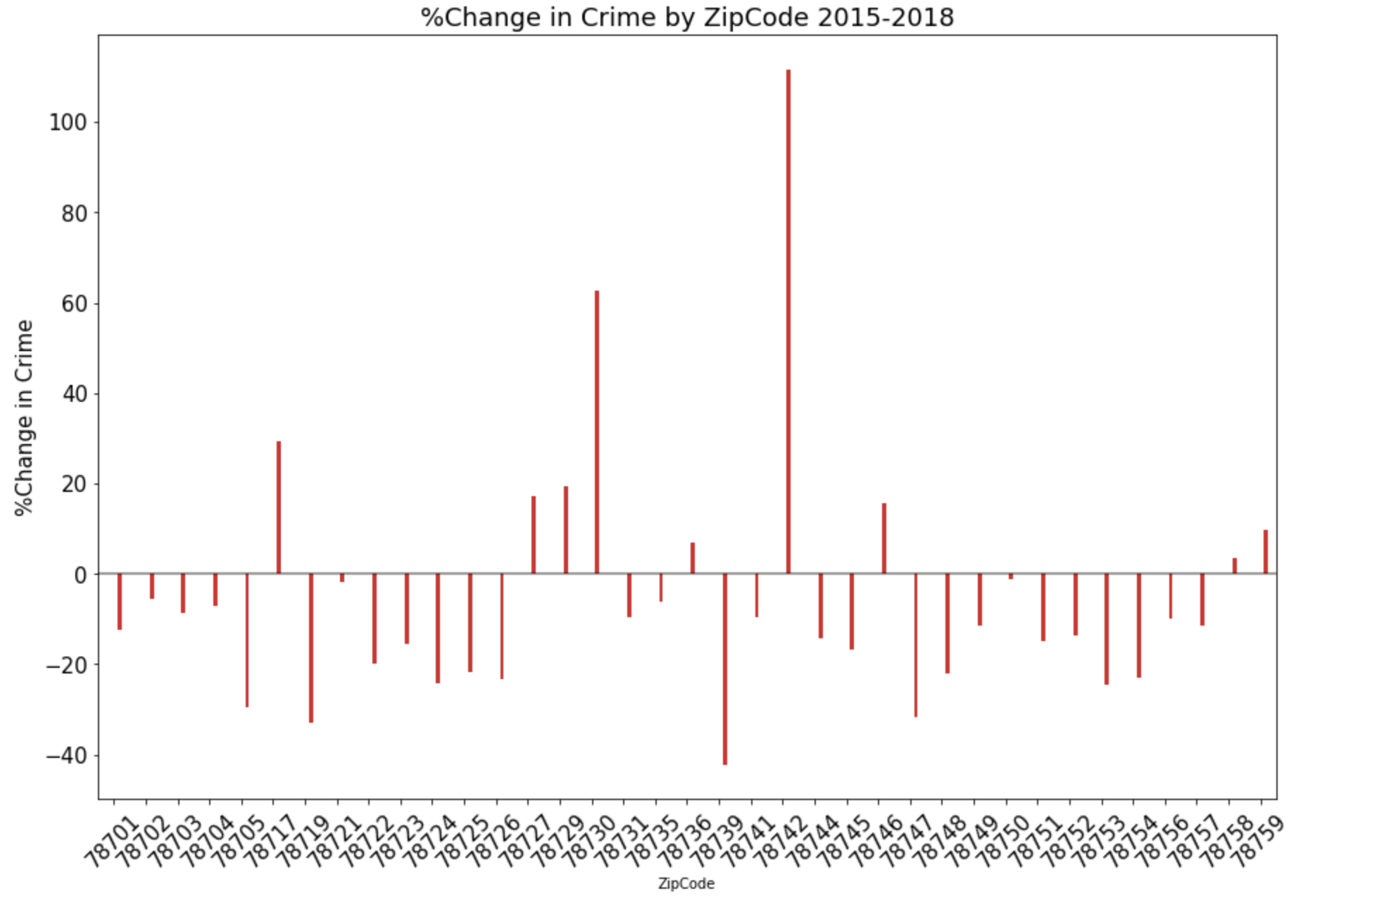
Percent change in crime by zip code – ALL CRIME (2015-2018)
78730 (west of 360 to River Place) and 78742 (east of 183 north of Ben White) had the highest % increase.
78719 (east of 183 south of Ben White) and 78739 (Circle C area) had the highest % decrease.

Slide 12
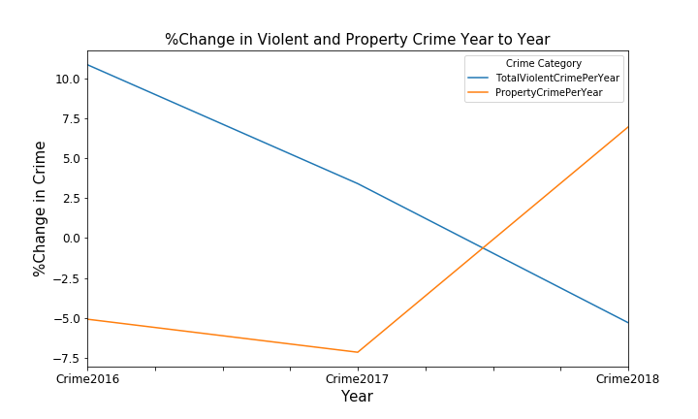
Percent change in crime (year over year)
Violent Crimes:
Murder
Rape
Aggravated Assault
Robbery
Property Crimes:
Theft
Auto-Theft
Burglary
Violent crime increased from 2015 to 2016 but steadily decreased in 2017 and 2018.
Property crime showed a spike between 2017 and 2018.

Slide 13
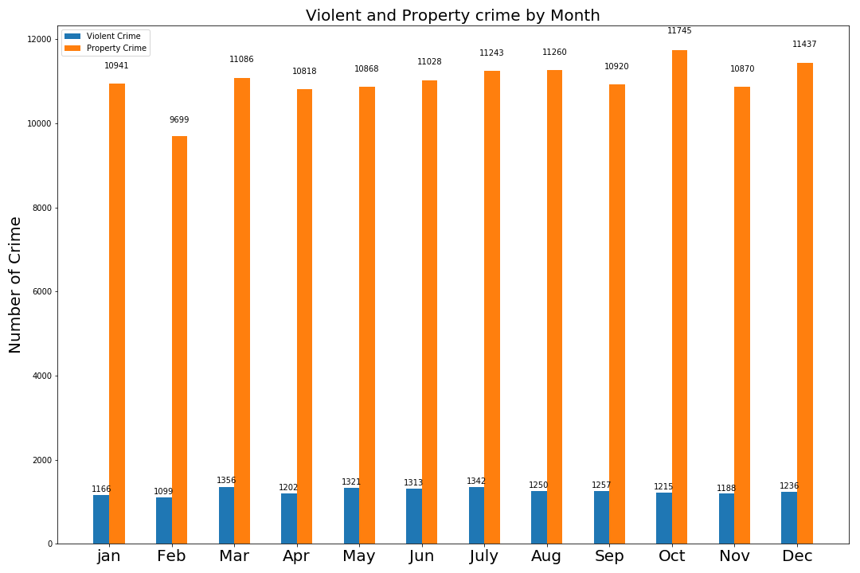
Crime by month (2015-2018)
February is the lowest crime month. October is the highest crime month.
Property crime far outpaces violent crime.

Slide 14
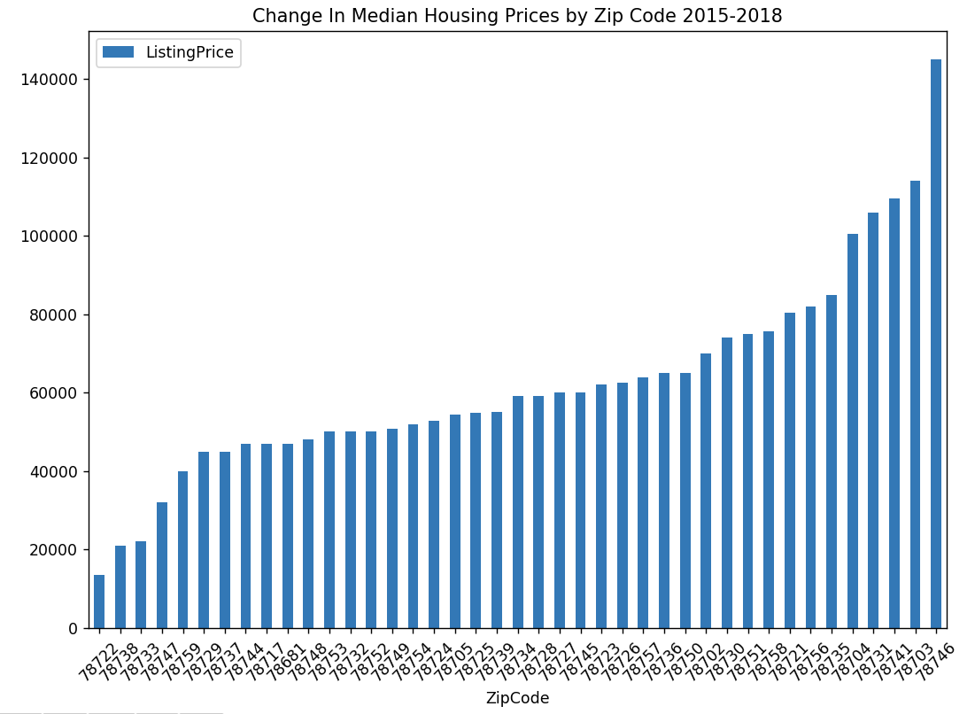
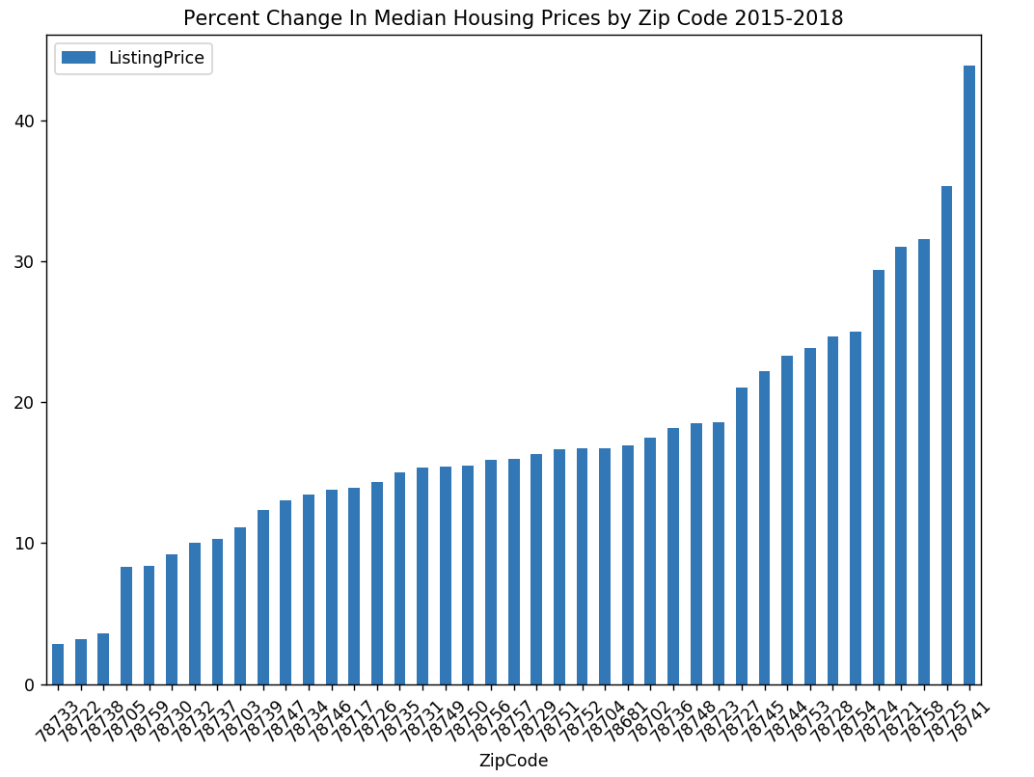
Change in median housing prices by zip code (2015-2018)
78722 (east of UT/I-35) and 78738 (Bee Cave area) had the lowest $ increase.
78703 (Tarrytown) and 78746 (Westlake) had the highest $ increase.
78733 (far west Austin) and 78722 (east of UT/I-35) had the lowest % increase.
78725 (far east Austin) and 78741 (East Riverside) had the highest % increase.

Slide 15
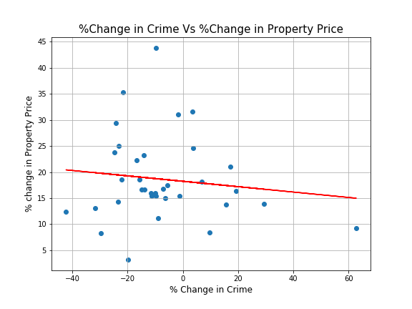
Final scatterplot – % change in crime vs. % change in home prices (2015-2018) p-value = 0.435 – no evidence against null hypothesis – can’t disprove r-value = -0.1382 – very small inverse relationship between home prices and crime r-squared = 0.0191– No relationship between home prices and crime
78741
(E. Riverside)
78739
(Circle C)
78730
(Riverplace)
78733
(far west Austin)

Slide 16
QUESTIONS?

